Slide 1

Vehicle safety new vs old cars
By Willow Rickman
Task 11

Slide 2

Increasing the time of the collision and the time the occupants take to stop
A safety feature that all cars need is the ability to stop accurately to minimize collisions. More modern cars can lessen the chance of collision more than older vehicles.
Having the ability to stop a collision reduces the impact of drivers and passengers, in modern vehicles methods to reduce harm during collisions include better working brake systems.
Quicker and more reactive braking systems allow for driver to best avoid a collision with another driver or obstacle.

Slide 3

Stability and spreading of external forces.
Modern cars have a stronger outer body casing that protects the passengers and drivers from dangers, this also helps give weight to the car making it much more stable on the roads.
Wider wheels are added to new cars and body of cars are made to be more stable on roads.
Lowering of the car explain. Principle B - example 'crumple zones' impact/force is spread, Principle B - example 'cars lower to ground' - ensures stability - refers to lower centre of gravity.

Slide 4

Protecting occupants of vehicle
If collisions do occur, then there have to be ways in keeping all people in a car to be safe.
In modern day cars, post 1970s, car companies have added features to keep all passengers of a vehicle to avoid injury when confronted with a crash. These methods include seatbelts and air bags.
Seatbelts keep the passenger from flying forward into or out the car. They are adjustable until a curtain level of force acts on it, then it locks into place to reduce forces from moving to occupant forward.
Air bags are placed in the front two seats to help protect the driver or passenger from slamming their head into the dashboard when the collision force acts on them.

Slide 5

Keeping the person inside the vehicle
Keeping the occupants inside the vehicle is the most important safety feature. To have methods to keep a person inside a vehicle while the vehicle is driving is important because it prevents severe injuries and even death.
Cars have many features that prevent someone from falling out of itself, these include seatbelts, doors, and locking systems.
Of course, doors and seatbelts help stop a person from slipping out the vehicle in a very affective manner, but if in the case for example, you have a child and can open the door where they sit, then the child increases the risk of injury and death significantly. In these kinds of situations, locking systems within car doors allows for all passengers to stay in the vehicle without the risk of the doors being opened.

Slide 6
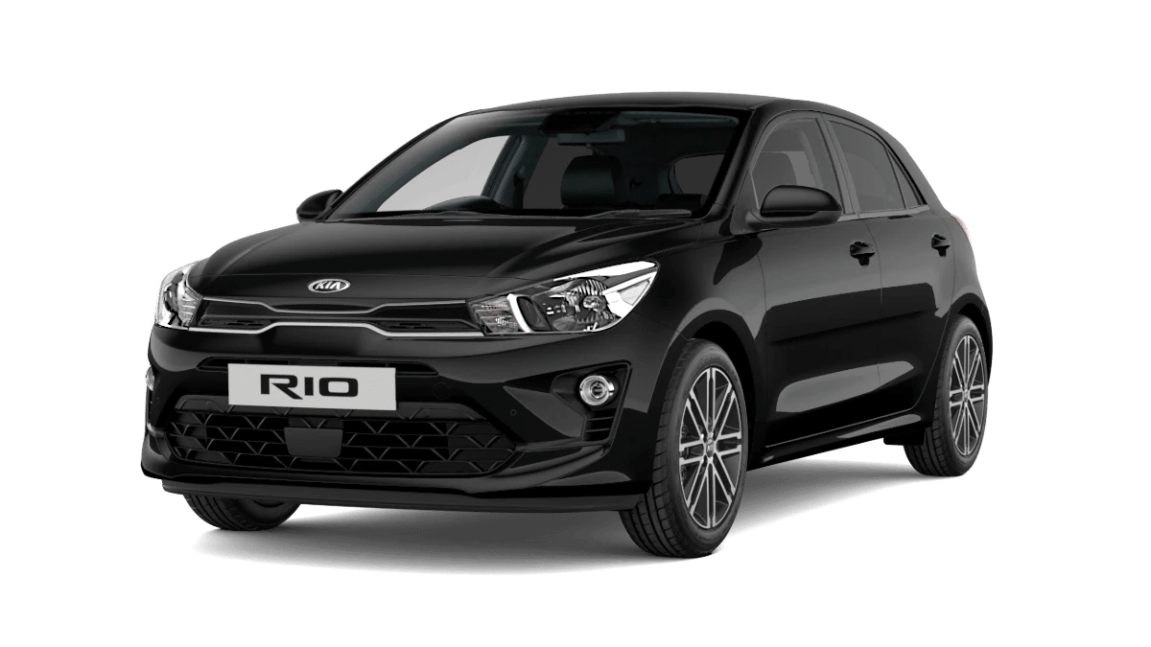
KIA RIO 2020 model

Slide 7

Safety features of the 2020 KIA RIO
The 2020 model of the KIA RIO has many safety features. These features include, an electronic stability control system, side curtain airbags on all ends of the interior part of the car to protect people from hitting their heads on the side of the car in the situation of a crash, airbags on both sides of the front console to protect driver and front passenger, and a reversing camera that allows the driver to part safely and accurately. The exterior of the vehicle is shaped to be more aerodynamic and to be able to cope with collision forces better than that of older vehicles.

Slide 8
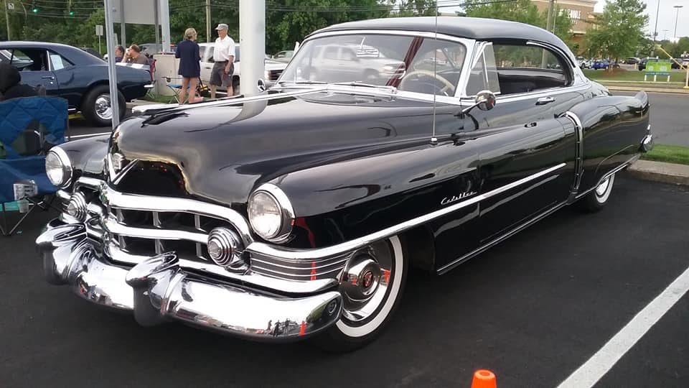
Cadillac 1950s series 62

Slide 9

Unsafe features of the series 62 1950s Cadillac
Cars like the Cadillac in 1950-60s were very rigid in driving and dangerous when collisions occurred. The car had been created with an unreliable braking system, “wandering” power steering, poor suspensions, iron hard dashboard that did not include airbags to protect the driver or passenger, and the body of the car was not designed to protect the occupants of the vehicle. This meant that when people did in fact become part f a collision, they were subjected to hitting the windshield, side pillars, steering wheel and these injuries would usually hospitalize people and even lead people's lives being taken. Cars like this Cadillac were not equipped with air bags and seatbelts, and when they were they were usually of poor quality.

Slide 10
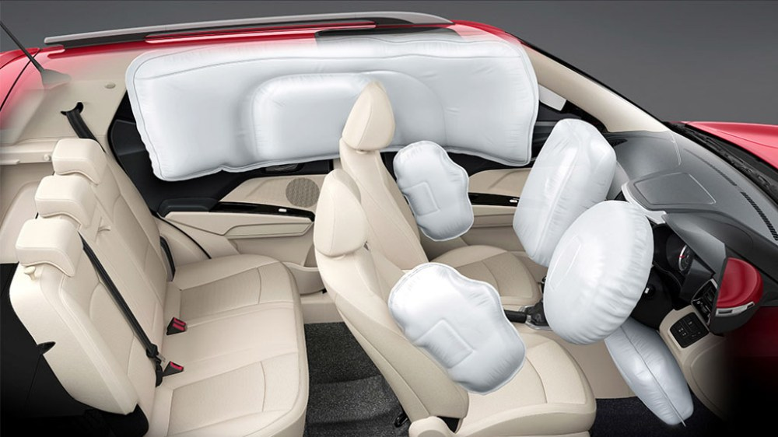
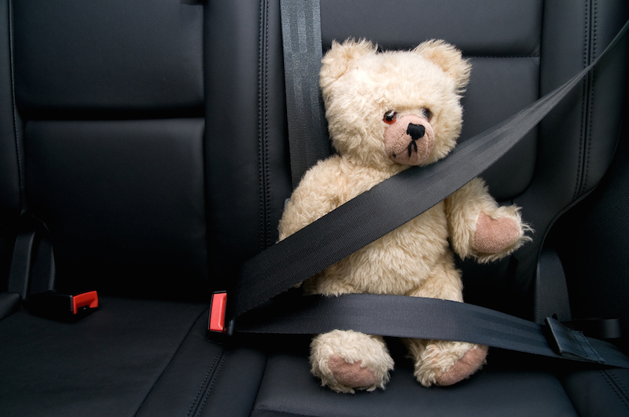
why is safety important to car design?
Designing safety features into a vehicle is extremely important. Incorporating safety features to vehicles protects everyone on the roads, and as roads get busier, this is a must for cars. The adding of safety features to cars reduce fatal injuries.

Slide 11
Improvements to car design
Inertia is the “Property of matter by which it continues in its existing state of rest or uniform motion in a straight line, unless that state is changed by an external force”.
Improvements that could be made to car safety design could include designing in automatic braking systems, double strapped seatbelts to reduce apposing forces, and increasing crumple zones.

Slide 12

References
https://www.google.com/url?sa=t&rct=j&q=&esrc=s&source=web&cd=&cad=rja&uact=8&ved=2ahUKEwjZvcGMyOP5AhXcTGwGHbdoCTcQFnoECBEQAw&url=https%3A%2F%2Fhowsafeisyourcar.com.au%2Fkia%2Frio%2F2020&usg=AOvVaw17HULS4nrZXpLtU3lI8ffQ
Is it possible that antique vehicles from the 50’s-60’s may actually be safer than more modern cars even with all the new technology and safety features because they were made with harder metal back than? – Quora
https://www.google.com/url?sa=t&rct=j&q=&esrc=s&source=web&cd=&cad=rja&uact=8&ved=2ahUKEwjrnYeEzOP5AhWlDrcAHZ__CsYQFnoECAUQAw&url=https%3A%2F%2Fwww.thoughtco.com%2Fmajor-laws-of-physics-2699071&usg=AOvVaw1K9VmNnMuKS-l35lnGCcGm
what is inertia - Google Search

